Slide 1

Note: The data and information in this document is reflective of a hypothetical situation and client. This document is to be used for KPMG Virtual Internship purposes only.
Sprocket Central Pty Ltd
Data analytics approach
[Division Name] - [Engagement Manager], [Senior Consultant], [Junior Consultant]

Slide 2
Note: The data and information in this document is reflective of a hypothetical situation and client. This document is to be used for KPMG Virtual Internship purposes only.
Agenda
Introduction
Data Exploration
Model Development
Interpretation

Slide 3
Note: The data and information in this document is reflective of a hypothetical situation and client. This document is to be used for KPMG Virtual Internship purposes only.
Introduction
Customer Analysis
The following factors will be considered.
Age distributions
Number of bike purchases in 3 years / percentages purchases
Job industry category.
Wealth segments

Slide 4
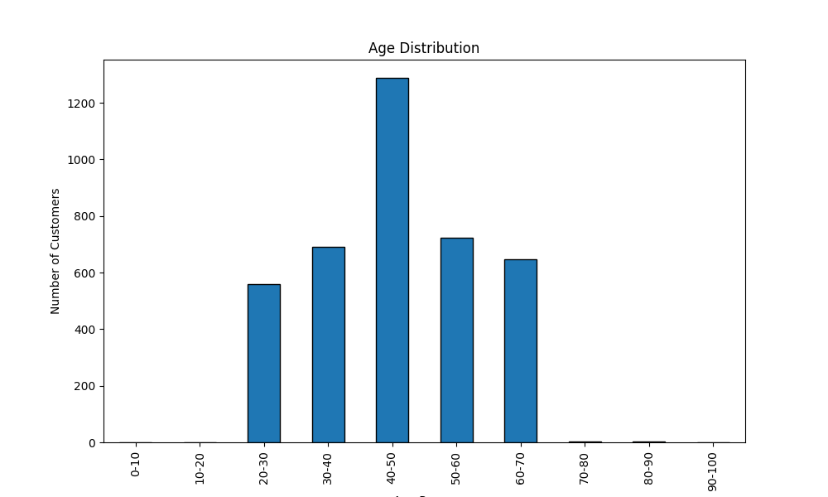
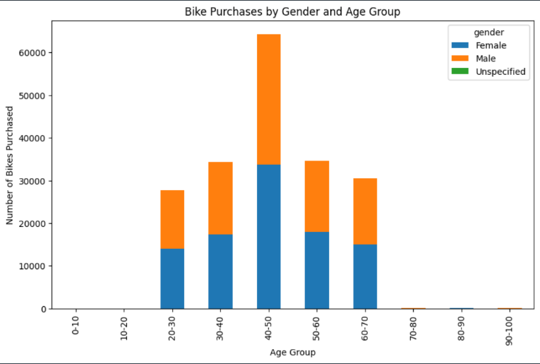
Note: The data and information in this document is reflective of a hypothetical situation and client. This document is to be used for KPMG Virtual Internship purposes only.
Data Exploration
Age Distribution between customers.
No data for ages 0-20 and 90-100.
More customers are more from the age group of 40-49 , followed by 50-59 & 60-69
Age group 40-50 has a high count in terms of bike purchased in previous years with a slightly greater female ratio

Slide 5
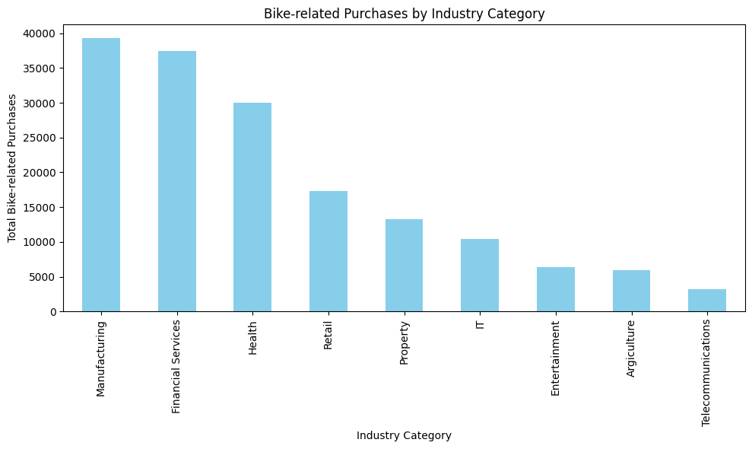
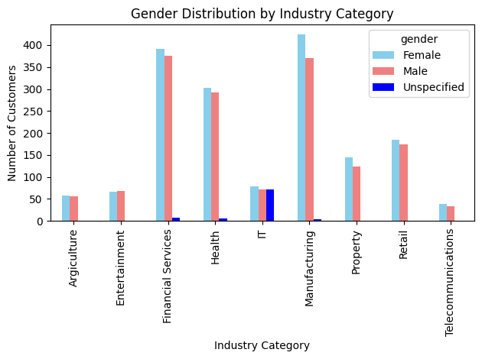
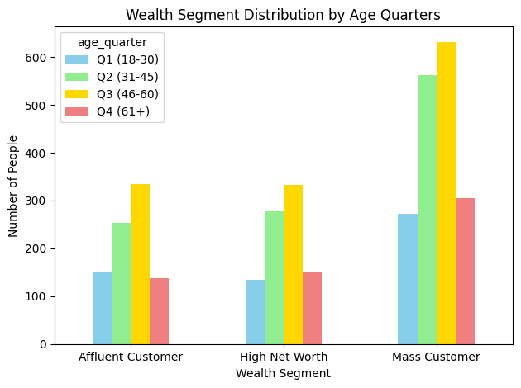
Note: The data and information in this document is reflective of a hypothetical situation and client. This document is to be used for KPMG Virtual Internship purposes only.
Data Exploration
Industry Segment
Most customers are from Manufacturing, Financial and health industries
We should focus mostly on these industry classes
Wealth Segment
In all ages, the number of Mass Customers is the highest so we should mostly focus on this social class before others.
We should also focus mostly on the second and third quadrant

Slide 6
Note: The data and information in this document is reflective of a hypothetical situation and client. This document is to be used for KPMG Virtual Internship purposes only.
Model Development
Classification for Identifying High value customers.
Target Female Customers from Ages 40 – 50
Target Customers In Manufacturing, Financial and Health Industries
Target Mass Customers Social class

Slide 7
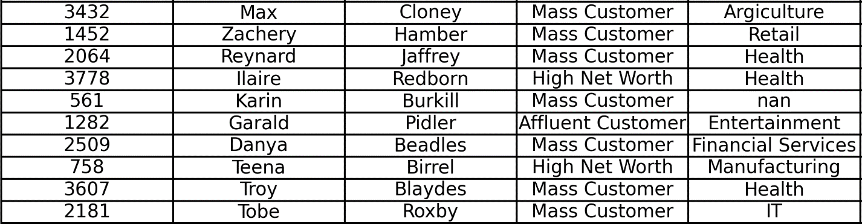
Note: The data and information in this document is reflective of a hypothetical situation and client. This document is to be used for KPMG Virtual Internship purposes only.
Interpretation
Top High Value Customers Interpretation
The table summarises the top ten high value customers.
It comprises Customer names,customer names,Wealth segments and the industries involved.

Slide 8
Note: The data and information in this document is reflective of a hypothetical situation and client. This document is to be used for KPMG Virtual Internship purposes only.
Thank You

